Slide 1
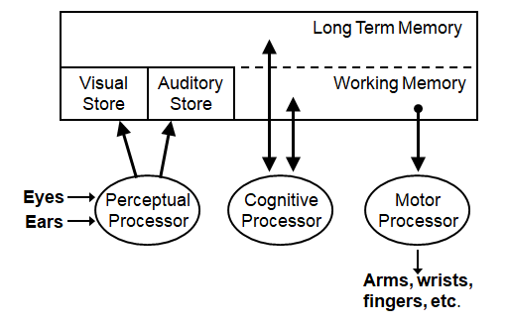
Model Human Processor (MHP)
Predictive models such as the Model Human Processor (MHP) and the Keyboard Level Model (KLM), are a priori (pre-experience) models . They give approximations of user actions before real users are brought into the testing environment.
Descriptive models such as State Networks and the Three-State Model provide a framework for thinking about user interaction . They help us to understand how people interact with dynamic systems.

Slide 2
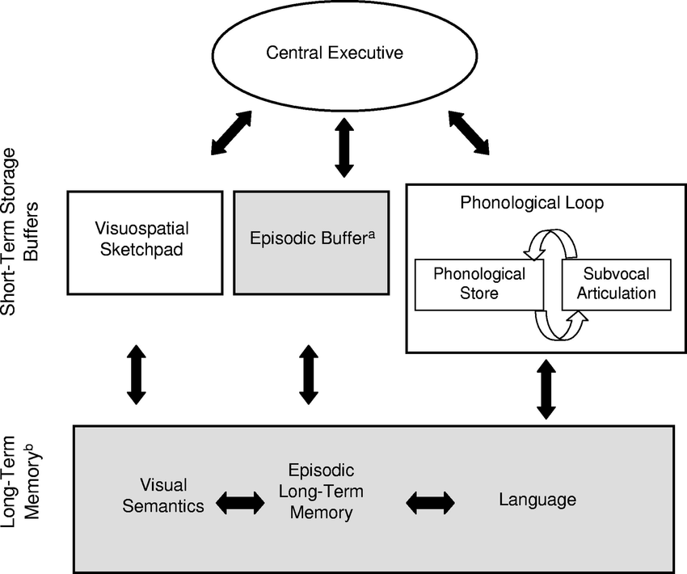
Working Memory Model - Baddeley and Hitch's multicomponent model

Slide 3
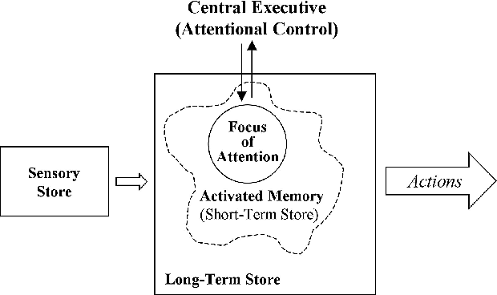
Working Memory Model - Cowan's Embedded-processes Model
Information enters through a sensory store, activating features in long-term memory
The activated portion of long-term memory holds features, including newly learned information
The focus of attention is controlled conjointly by voluntary processes (central executive) and involuntary processes (attentional orienting system)
The model emphasizes links between memory and attention

Slide 4
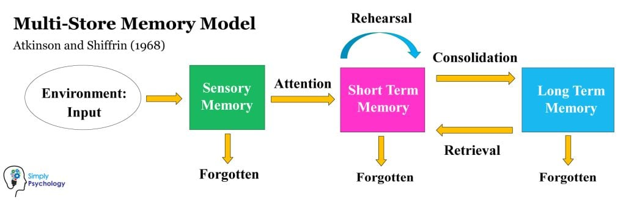
Working Memory Model - Atkinson and Shiffrin’s Model
Consists of three separate components: the sensory register, short-term memory, and long-term memory.
The model explains that information from the senses is first placed into the sensory register, then, if attended to, it is transferred to the short-term store.
If the information in the short-term store is repeated over and over, it is encoded into permanent long-term memory.
The model emphasizes the flow of information through these three stages and focuses on modularity, attention, and purpose

Slide 5
Short Term Memory
Long Term Memory
Information in LTM is stored as a network of schemas
LTM is not stored in one specific region of the brain but is stored in the form of circuits throughout the nervous system
LTM is responsible for encoding, storage, and retrieval of information
LTM has an unlimited capacity
The duration of LTM depends on the way memory was encoded and the retrieval of memory.
Limited capacity
Temporal decay, information spontaneously decays over time without rehearsal
Chunk capacity limits, information can be combined into larger units to increase the number of items that can be held in memory
Sensitivity to interference, new information can disrupt the recall of older information
Example: Dialling a phone no., remembering a short order list

Slide 6
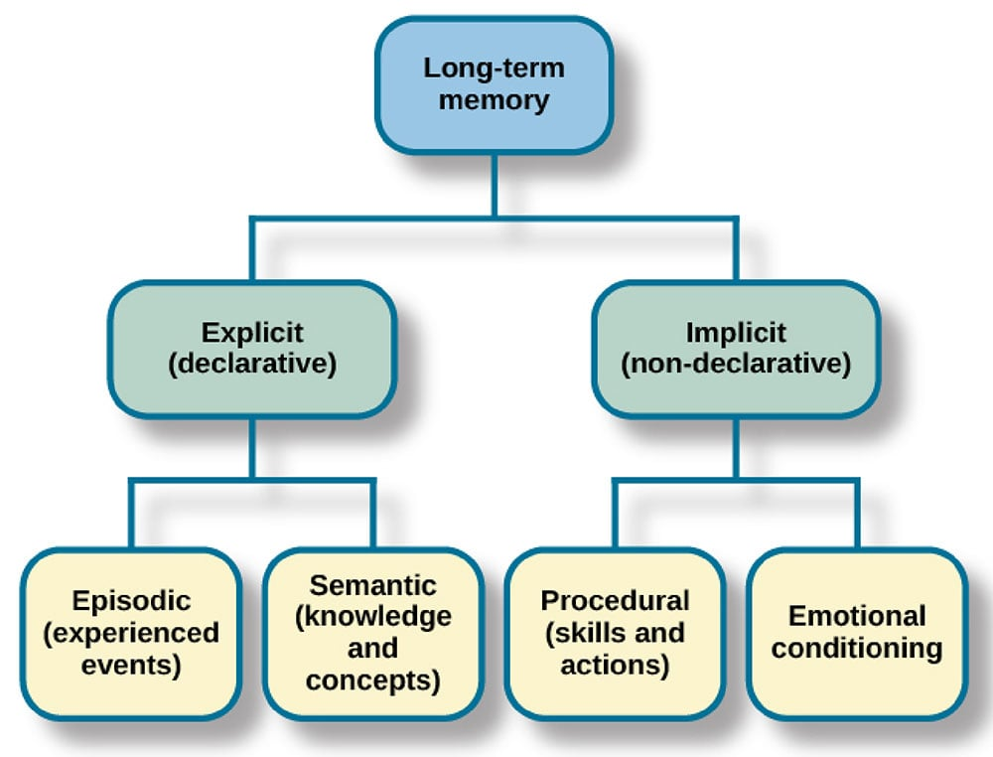

Slide 7
MHP: Example 1: perception, visual
Compute the frame rate at which an animated image on a video display must be refreshed to give the illusion of movement
Consider: cycle time of the Perceptual Processor: closely related images which appear nearer in time than the processing time will be fused into a single image.
frame rate > 1/cycle time of processor = 1/(100 msec frame) = 10frames/second
Frame rate should be faster than this. Upper bound specified by for how fast the rate needs to be can be found by redoing the calculation.
max frame rate for fusion = 1/(50 msec/frame) = 20 frames/sec

Slide 8
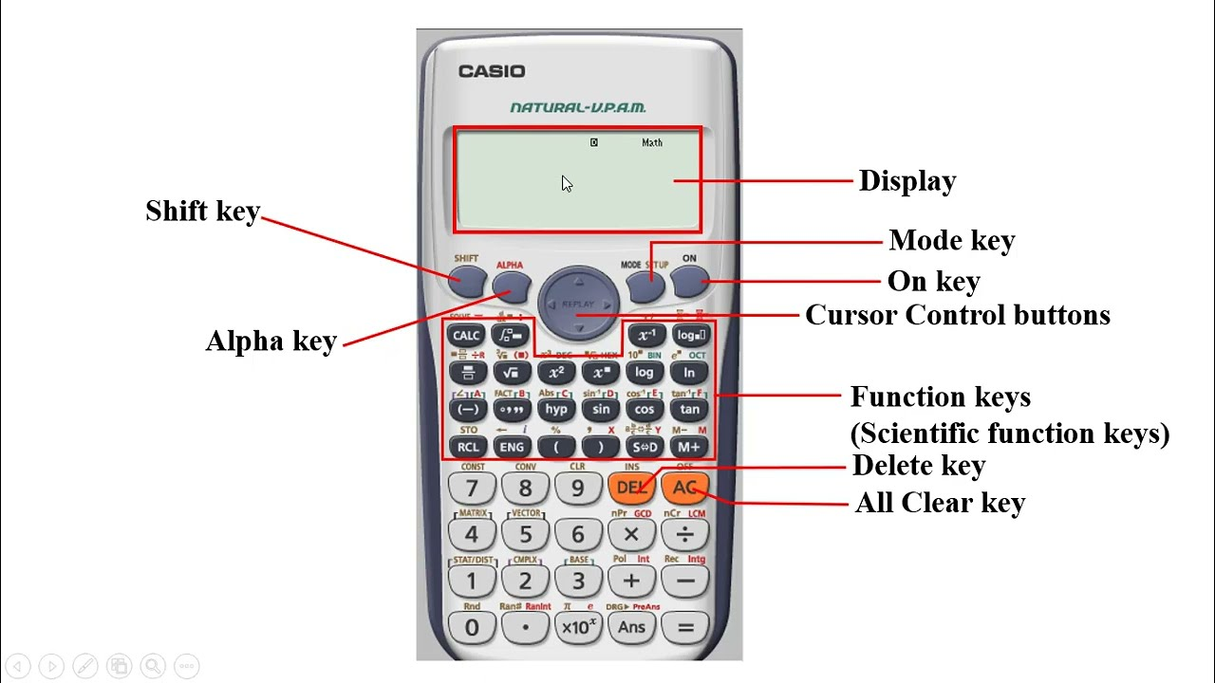
MHP: Example 2: motor skills typing behaviour
On a certain pocket calculator, the heavily used gold F button employed to sift the meaning of keys is located on the top row. How much time would be saved if it were located in a more convenient position just above the numbers?
Assume that the position of the 5 button is a fair representation of where the hand is just before pressing the F button. From the diagram, the distance from the 5 button to the present F button is 2 inches, to the proposed location 1 inch.
The button is .25 inch wide. Fitt's Law = Im log2 (D/S + .5) where Im is expected to be about 100 msec/bit. So the difference between the two locations in time is
T = 100 [log2 (2/.25 + .5) - log2 (1/.25 + 5)] = 100 (3.09 - 2.17) = 90 msec

Slide 9
MHP: Example 3: cognitive, working memory
A programmer is told verbally the one-syllable file names of a dozen files to load into his programming system. Assuming all the names are arbitrary, in which order should the programmer write down the names so that he remembers the greatest number of them (has to ask for the fewest number to be repeated).
Twelve arbitrary file names means the programmer has to remember 12 chunks (assuming one chunk/name) which is larger than the storage capacity of working memory, so some of the file names will be forgotten.
The act of trying to recall the file names will add new items to working memory, interfering with the previous names.
The items likely to be in working memory but not yet in long-term memory are those from the end of the list.
If the he tries to recall the names from the end of the list first, he can snatch some of these from Working memory before they are displaced.
Thus the programmer should recall the last names first and then the others.

Slide 10
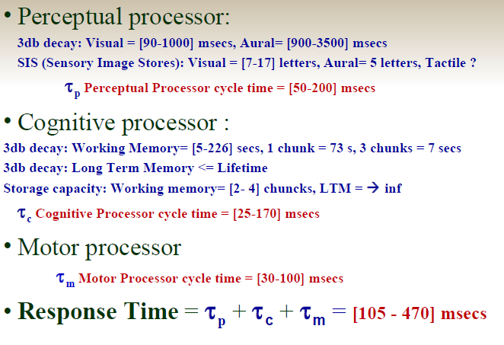
Timing values: Human Processor Model

Slide 11
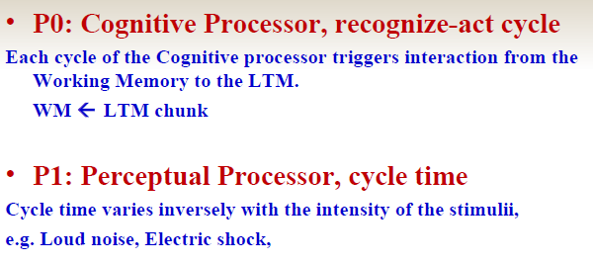
Model Human Processor, MHP Principles:

Slide 12
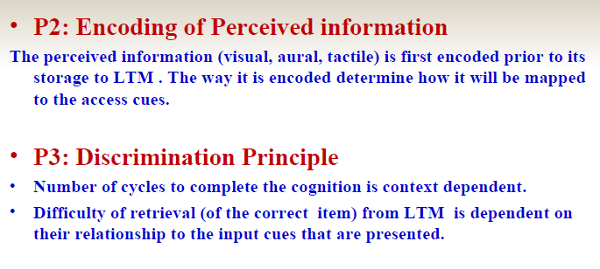
Model Human Processor, MHP Principles:

Slide 13
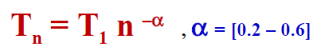
Model Human Processor, MHP Principles:
P4: Cognitive Processor Rate
Variable Rate Principle
Cycle time T_{c} is shorter when greater effort is induced by increased task demands or information loads; it also diminishes with practice.
Cognitive processing becomes faster
Under increased task demands (e.g. panic situations)
After practice
Performance Gain: due to repeated practice
where n is the number of attempts,
T₁ the initial time,
T_{n} the time at the n^{th} repetition.

Slide 14
Model Human Processor, MHP Principles:
P7: Uncertainty Principle
Decision time increases with the uncertainty about the judgment to be made, requires more cognitive cycles
Hicks Law - Choice Reaction Time
Models human reaction time under uncertainty
Decision time T increases with uncertainty about the judgment or decision to be made
T = k H, where H is the entropy of the decision and k is a constant.
H =
H = log₂(n + 1), if probabilities are equal

Slide 15
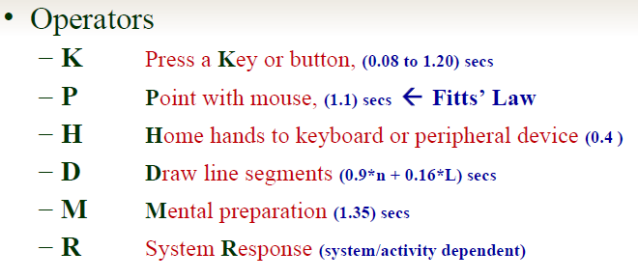
Keyboard Level Model (KLM)
The KLM is a practical design tool that can capture and calculate the physical actions a user will have to carry out to complete specific tasks
The KLM can be used to determine the most efficient method and its suitability for specific contexts

Slide 16
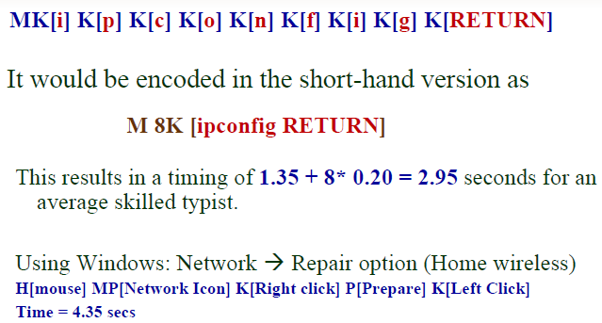
KLM – Encoding Methods
Encoding methods define how the operators involved in a task are to be written, e.g., ‘ipconfig’ With CLI in a command window:

Slide 17
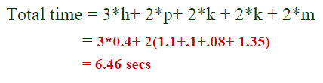
KLM Example 2
Consider the scenario of correcting a
mirtake -> mistake
Move hand to mouse H[mouse]
Position mouse after the bad char PK[Left]
Return to keyboard H[keyboard]
Delete bad char MK[backspace]
Type in new char K[char]
Reposition insertion point H[mouse]MPK[Left]

Slide 18
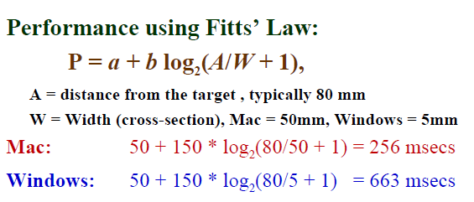
Menu selection: Macintosh OS vs. Windows
Menu placement:
Macintosh: Aligned with the edge (No offset) -> Users need not be very accurate when hitting the target. Typically, they stop 50 mm from the edge
Windows: Offset by the Title bar (pull down) -> Need more accuracy as the Width of target is 5 mm.

Slide 19
Rules for Keeping/Deleting the M operator
Rule 0: Task Initiation and Termination
Place M in front of all K where you want to enter new text and all P (mouse) that selects commands.
Keep the mental operator (M) at the beginning and end of a task, as the user engages in mental processes to initiate and terminate the task.
Rule 1: Familiarity with the Task
If M is also associated with the previous operator, then delete it, e.g. PMK -> PK
Rule 2: Task Complexity
If there is a string of M then delete all except the first.
Keep the mental operator (M) for tasks that involve complex planning, problem-solving, or decision-making.
Delete the mental operator (M) for tasks that are simple and straightforward, requiring minimal mental effort.
Example: Planning a project schedule (complex task), versus entering data into a spreadsheet (simple task).

Slide 20
Rules for Keeping/Deleting the M operator
Rule 3: Problem-Solving and Decision-Making
If K is a redundant terminator then delete the M in front of it, e.g.
M<command> K M<argument> K -> M<command> K <argument> K
Rule 4: Skill and Expertise
Delete M, if K terminates a command string. Keep M, if K terminates an argument string, e.g.
M<command> K -> <command> K
M<argument> K -> M <argument> K
Keep the mental operator (M) for novice users or tasks that require learning and adaptation.
Delete the mental operator (M) for experienced users or tasks that are routine and well-practiced.

Slide 21
Ex 1: Set column width to 5 in a spreadsheet application
Mental Insertion (M): The user decides to adjust the column width and mentally prepares to perform the action. (M)
Keystroke (K) - Command Entry: The user presses the necessary keystrokes to access the column width adjustment command. This includes locating the command in the menu or toolbar and selecting it. (M) K [Column]
Mental Insertion (M): The user mentally prepares to specify the width value. (M)
Keystroke (K) - Argument Entry: The user enters the value "5" using the keyboard to specify the desired column width. (M) K [5]
Keystroke (K) - Command Execution: The user confirms the width value by pressing the Enter key or a similar keystroke to execute the command and apply the specified width to the column. K [Enter]
Ex 2. Correct the word ‘Catelog’
Ex 3. Save a file on MAC using Menu

Slide 22
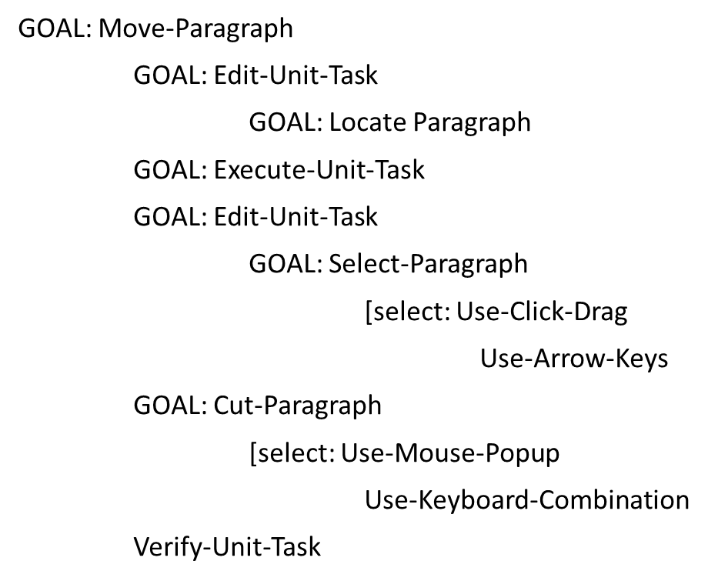
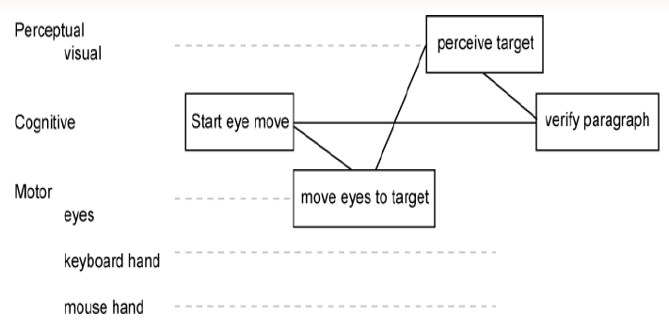
GOMS Analysis of a Cut-and-Paste Operation
GOMS Component
Goals - Tasks are deconstructed as a set of goals and subgoals.
Operators - Tasks can only be carried out by undertaking specific actions.
Methods - Represent ways of achieving a goal
Selection Rules - The method that the user chooses is determined by selection rules. In this case selection rules are – Click and Drag, Arrow Keys, Mouse/Pop-up, Keyboard combination
CPM-GOMS – assumes Cognitive, Perceptual, Motor processors function in parallel
CPM-GOMS is based directly on the Model Human Processor
CPM-GOMS uses Program Evaluation Review Technique charts

Slide 23
Modeling Structure
Structural models can help us to see the relationship between the conceptual components and the physical components of the system. Dynamic models allow us to view the design in action.
Modeling Structure - Hick’s Law
Menu listing order must be logical and relevant
A lower Hick’s Law value (fewer choices or simpler decision paths) leads to faster decision-making.
A higher Hick’s Law value means there are more choices or complex options, leading to slower decision-making.

Slide 24
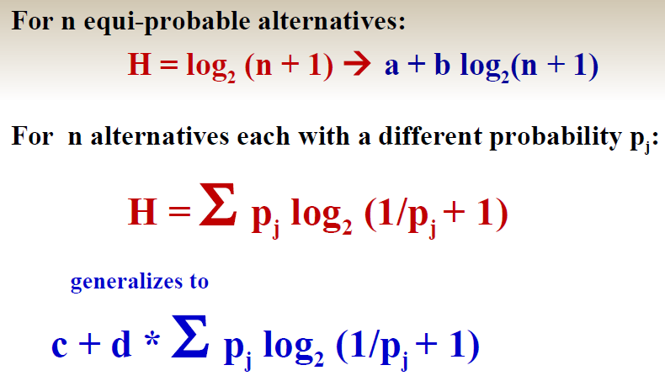
Modeling Structure – Other Forms of Hicks Law
a =50 and b= 150

Slide 25
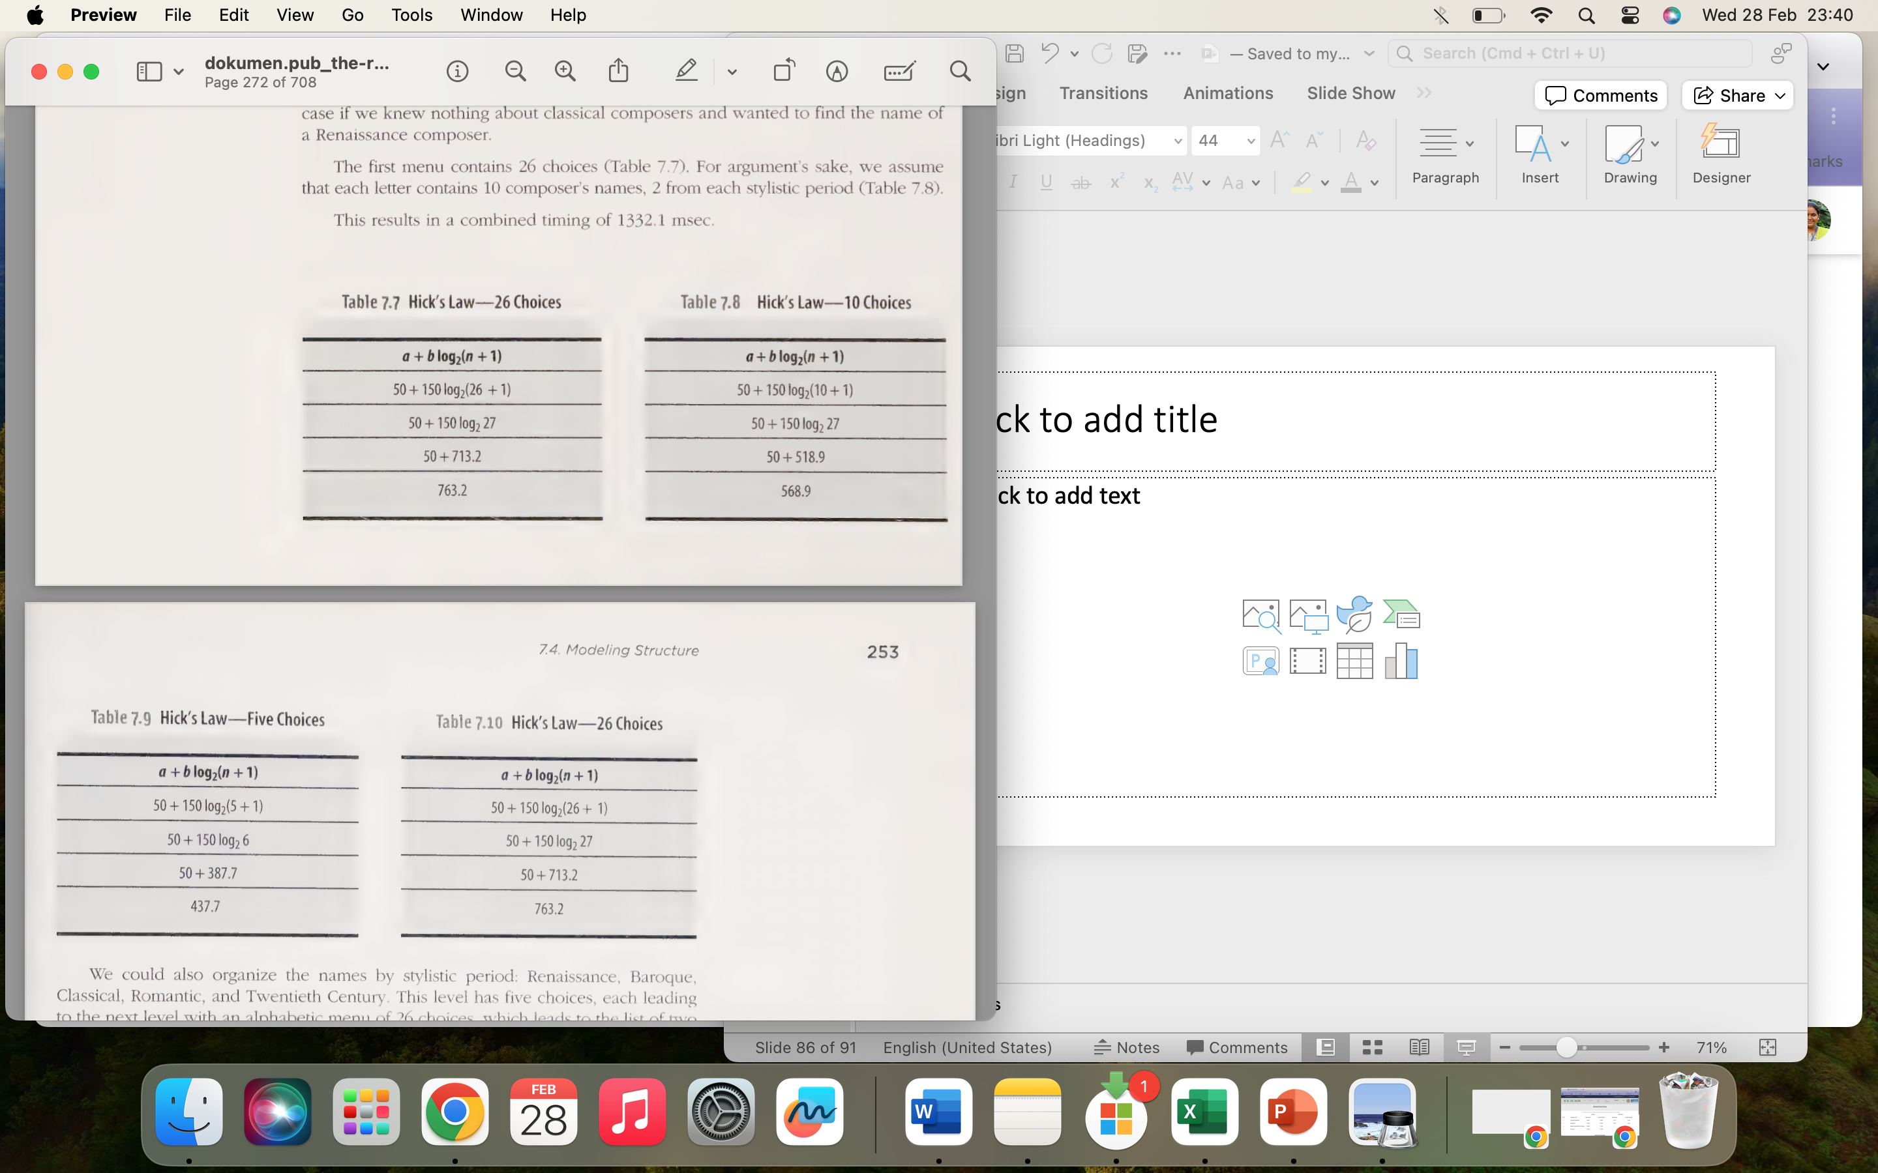
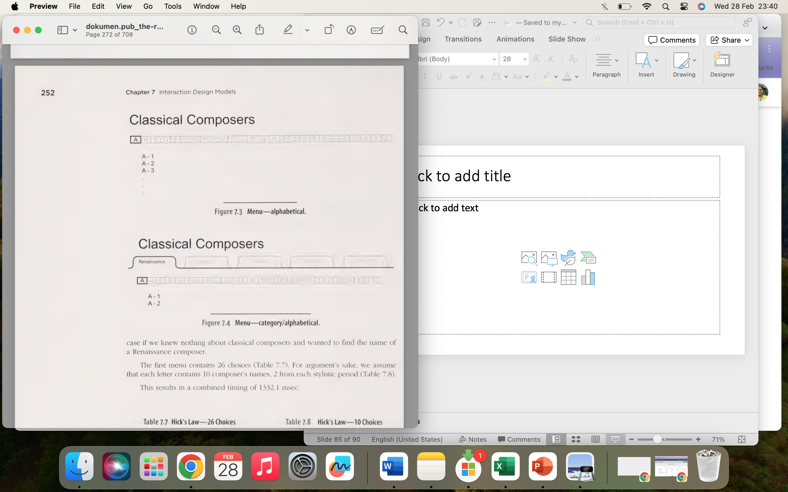

Slide 26
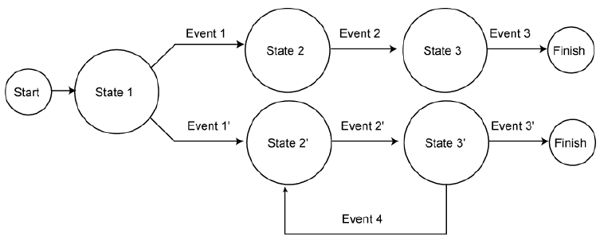
Modeling Dynamics – State Transition Networks
STNs are appropriate for showing sequential operations that may involve choice on the part of the user, as well as for expressing iteration.

Slide 27

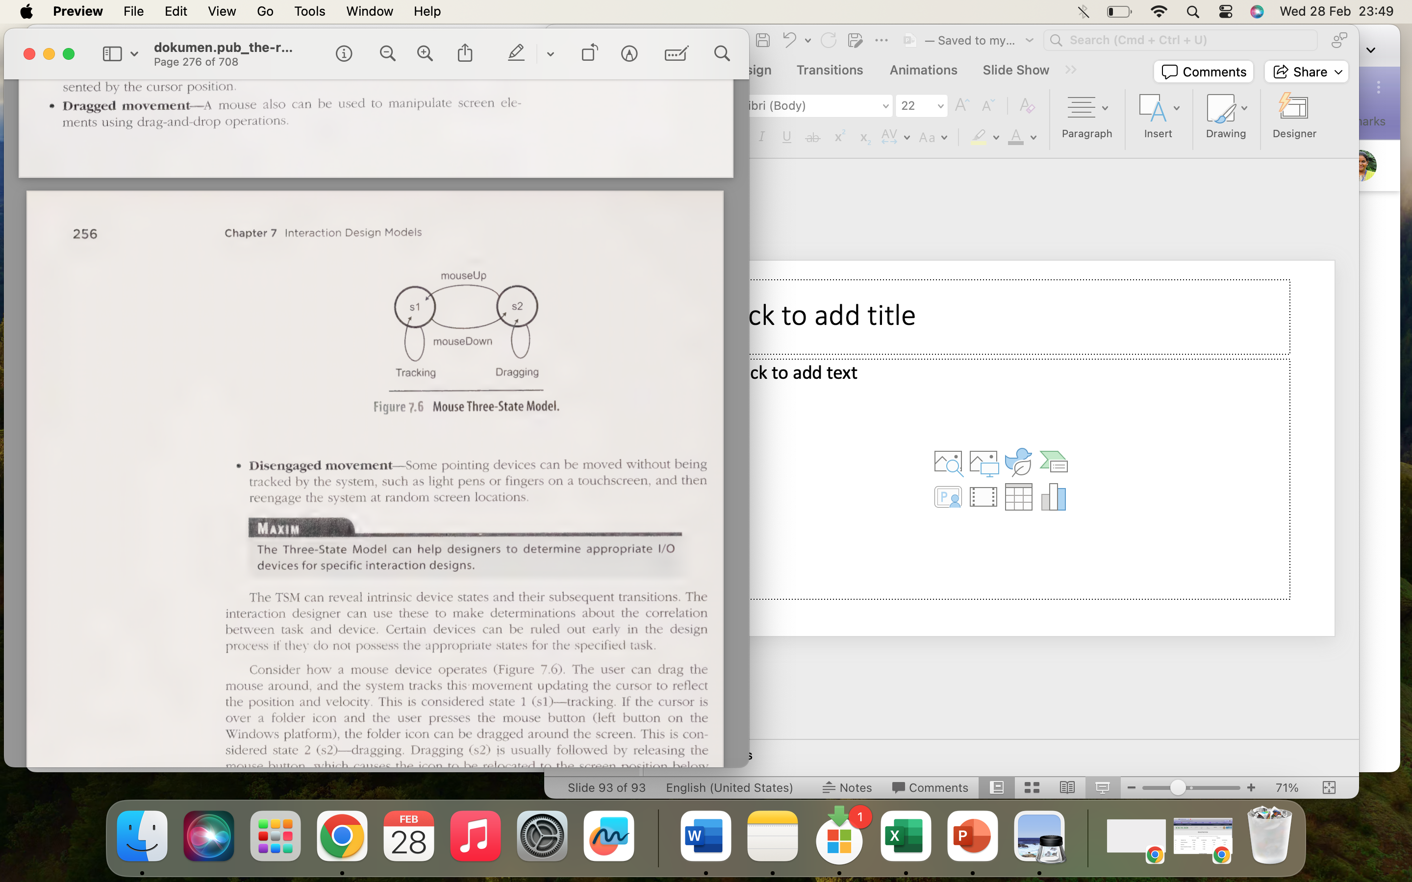
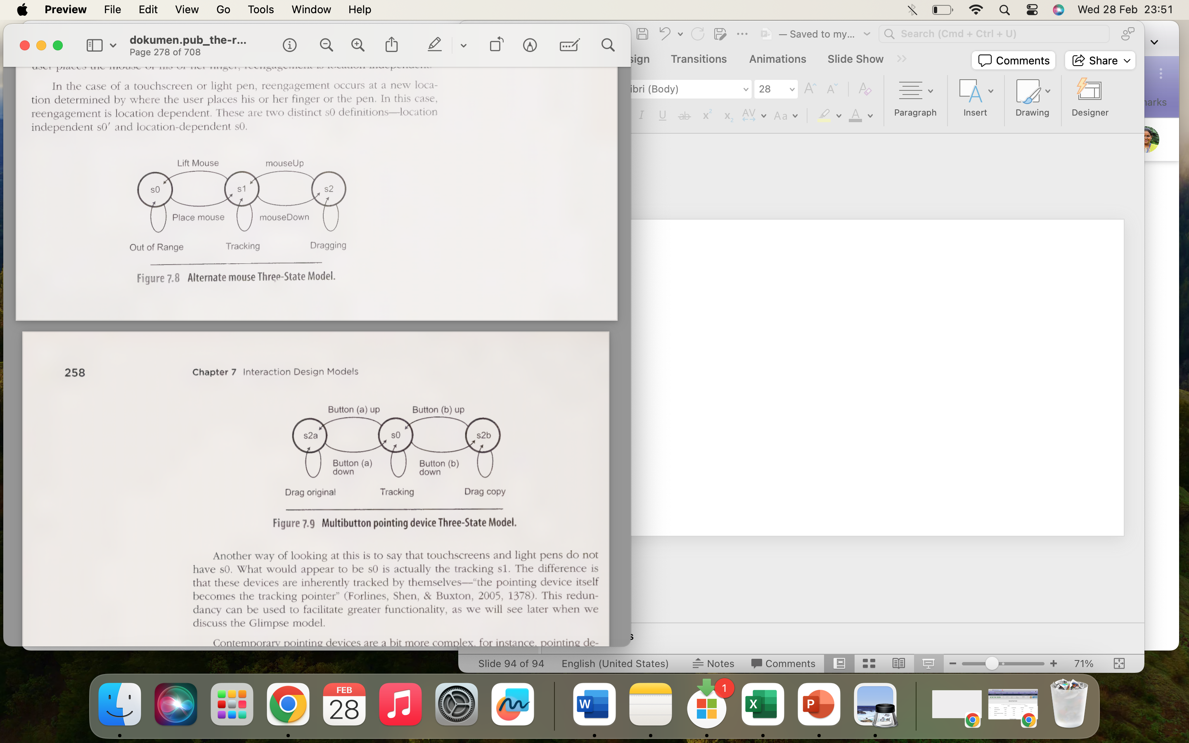
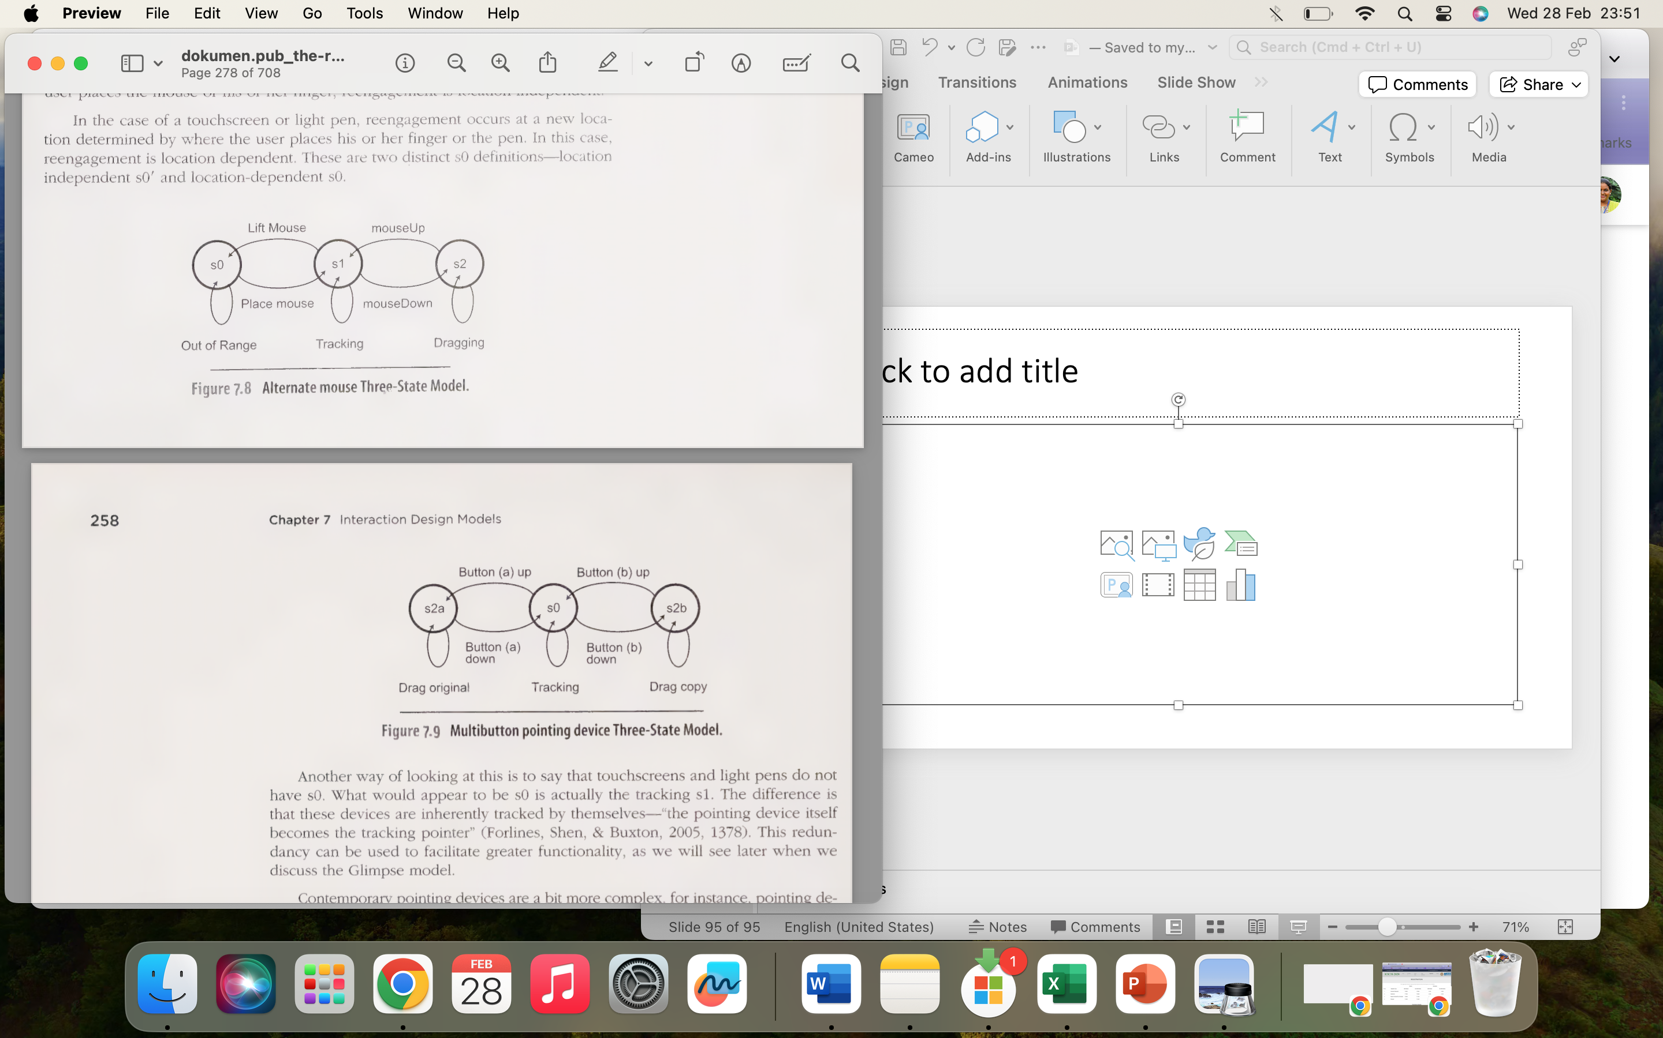
Modeling Dynamics – Three-State Model
The Three-State Model can help determine appropriate I/O devices for specific interaction designs, device states and their subsequent transitions
The Three-State Model (TSM) is capable of describing three different types of pointer movements – tracked, dragged, disengaged movement

Slide 28
Example of STM: ATM Interaction
Initial State: Idle - User approaches the ATM and inserts their bank card.
Transition to State: Card Inserted - The ATM reads the card information and prompts the user to enter their PIN.
Transition to State: PIN Entered - The user enters their Personal Identification Number (PIN).
Transition to State: PIN Verified - The ATM verifies the entered PIN with the bank's database.
If the PIN is correct, the ATM transitions to the "Transaction Menu" state.
If the PIN is incorrect, the ATM prompts the user to re-enter the PIN.
Transition to State: Transaction Menu - The ATM displays options such as "Withdraw Cash," "Deposit," "Check Balance," etc.
Transition to State: Withdraw Cash - The user selects the "Withdraw Cash" option and enters the desired amount.
Transition to State: Cash Dispensed - The ATM dispenses the requested amount of cash.
If the ATM runs out of cash, it transitions to the "Out of Service" state.
Otherwise, it returns to the "Transaction Menu" state.
Transition to State: Idle (End of Transaction) - After completing the transaction, the ATM returns to the idle state, ready for the next user.
Transition to State: Out of Service
If the ATM encounters an error or runs out of cash during a transaction, it transitions to the "Out of Service" state.
The ATM displays a message informing users that it is temporarily unavailable and prompts them to use another ATM.
Transition to State: Maintenance
A technician accesses the ATM for maintenance purposes.
During maintenance, the ATM is not available for user transactions.

Slide 29
Incorrect
Card Inserted
Pin Entered
Pin Error Verified
Correct
Transaction Menu
Withdraw Cash
Cash Dispensed
Idle

